Slide 1


Week 12 Assignment 1 – Customer Value Metrics
Capstone A - Week 10 - Team 8
31 July 2021
Vincent Maher, Kyle Frizol, Ruth Ngiendo, Matthew Pearce

Slide 2
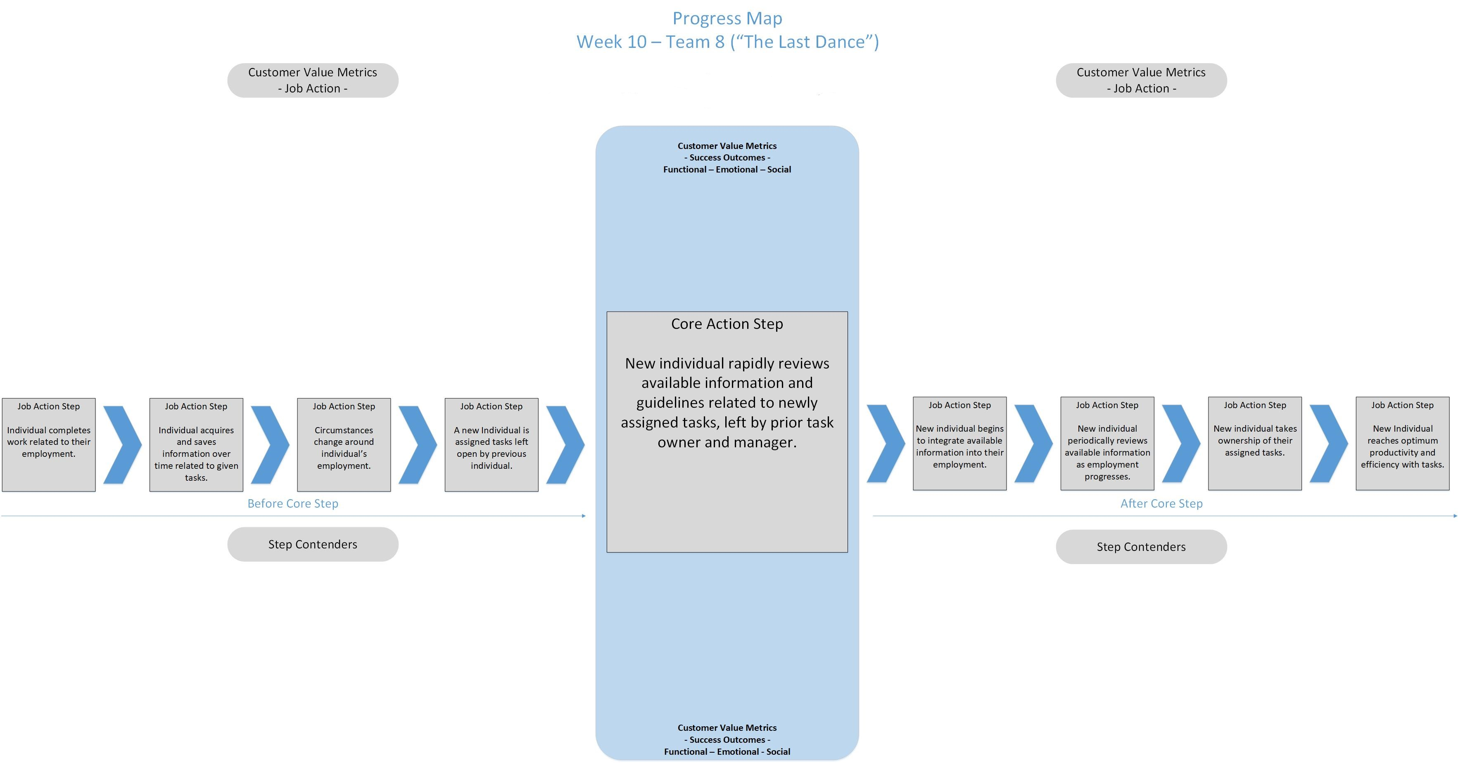
Reduces cost of redirection when work is incomplete.
Reduce the learning time to reach the acceptable level of performance
Enhanced and defined transition process
New task owner has material
references to guide tasks
Turnover Management Business Model – "Microsoft Vault"
Job Statement: Effective turnover management within organizations requires proper preservation of workflows and documents in order to seamlessly maintain productivity.
Maintained productivity of team as a whole
Frequently referenced information is intuitively organized
Reduces the need for detailed and constant supervision
Minimize the time it takes to find information
Assurance of continuation of workflow during change
No downtime for tasks during transition
Systems integrated to support heightened productivity
Organization retains functional efficiency
Tasks remain completed during task-specific
education
Frequently referenced information is easily accessible
Learning curve timeframes reduced
Task hand-off/turnover time is reduced
Reduced likelihood of gap in workflow
Backtracking and workflow redundancy eliminated
Minimized cycle time due to work completion
Increase in availability of information
Maintained productivity during change
New task owner is qualified to take on tasks
Task-specific Info is easily accessible and readable
Minimize the time it takes to reference frequently accessed information
Workflows are easily updated and maintained
Completed work is actively catalogued for historical reference
Feel supported and set up for success
Able to cross-reference past work
Properly
synchronized to organizational strategy
Reduced resources spent on job-specific training
Provided a clear picture of what effective work looks like
Colleagues do not experience workflow bottleneck

Slide 3
Minimize the likelihood that cost will be incurred to redirect process when work is incomplete
Minimize the time it takes on learning to attain acceptable levels of performance
Minimize the time it takes to adjust to change
10
Increase the number of written resources that new task owner has to guide onboarding
13
Increase frequency of completed work during an employee transition period
Minimize confusion in organization of frequently referenced information
1
4
7
16
Turnover Management Business Model – "Microsoft Vault"
Job Statement: Effective turnover management within organizations requires proper preservation of workflows and documents in order to seamlessly maintain productivity.
CVMS HERE
Increase the likelihood that there will be efficient work flow during change
2
Minimize the time it takes for detailed and constant supervision
5
Minimize the time spent integrating productivity systems
Increase the likelihood of organizational and functional efficiency
Increase probability of efficiently accessing frequently referenced information
21
Minimize the time it takes to find information
8
11
Minimize the time it takes to return to standard employee job completion rate
14
Minimize likelihood of task drop-off during onboarding of new employee
17
19
Minimize learning curve timeframes
Minimize task hand-off/turnover time
3
Minimize the time it takes to close the gap in workflow
Minimize the frequency of backtracking and workflow redundancies
Minimize the time it takes on a particular task
6
Increase the frequency of the availability of information
9
Increase the likelihood that there will be a maintained productivity during change
18
Minimize the time it takes to reference frequently accessed information
20
Increase the ease of workflow updates and organization
22
Increase seamlessness of cataloguing of completed work
12
Minimize likelihood that new employee is unprepared to pick up tasks
15
Increase the likelihood of organized and easily consumable work flow documents
Increase the number of options to cross-reference past work
Increase the likelihood of feeling supported and set up for success
Increase the likelihood to synchronize to organizational strategy
Minimize the time and resources spent on job-specific training
Wanted Outcomes
CVMs
Minimize the amount of time spent integrating effective work
Minimize the likelihood that colleagues experience workflow bottlenecks

Slide 4
https://wsu.zoom.us/rec/share/HJAkcPcBf6s5zFw9_pWQ8TVMs63DJewyjm8o69ApFIXQGLDGI1ZpC30GoreILU8l.bramoqsUYoYl1nG6?startTime=1627436859000

